Slide 1
Group 2: Nick Benjamin, John Goebel, Beth Grace, Joan Stone-Mays
There Goes the Neighborhood!

Slide 2
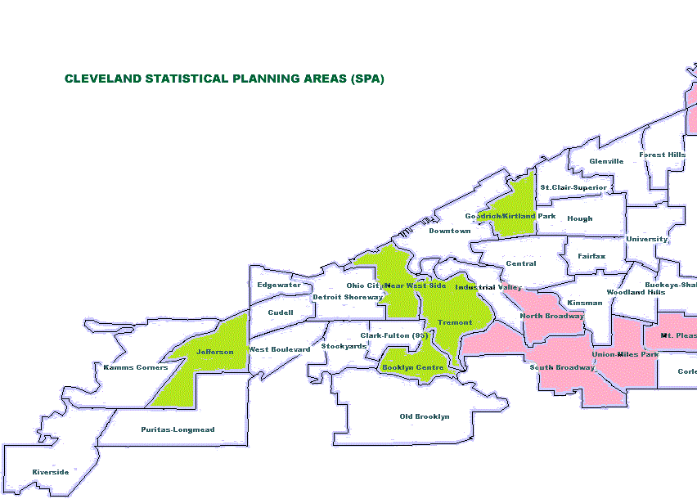
Core message or hypothesis for your project
If the land bank is involved in the neighborhood, then various neighborhood indicators should improve. The three indicators are home/property values, standardized test scores, and crime statistics. We chose these three because they point to both financial and quality of life improvements.

Slide 3
Describe the questions you and your group found interesting, and what motivated you to answer them
Does land bank involvement improve lower test scores? We found that there is a disparity in the data test scores.
Was there land bank activity in more affluent areas of Cleveland? Yes, by analyzing the data we found that there is a small amount of properties and they are being sold and renovated instead of demolished in these areas.

Slide 4



Summarize where and how you found the data you used to answer these questions

Slide 5
Describe the data exploration and cleanup process(accompanied by your Jupyter Notebook)
Beth to answer this question
John-

Slide 6
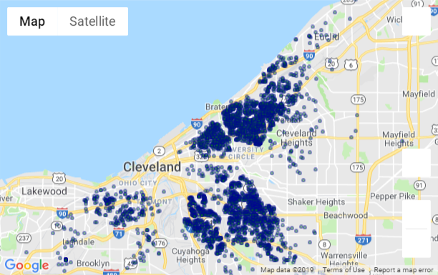
Describe the analysis process (accompanied by your Jupyter Notebook)
Current Land Bank Properties (As of June 15, 2019)

Slide 7
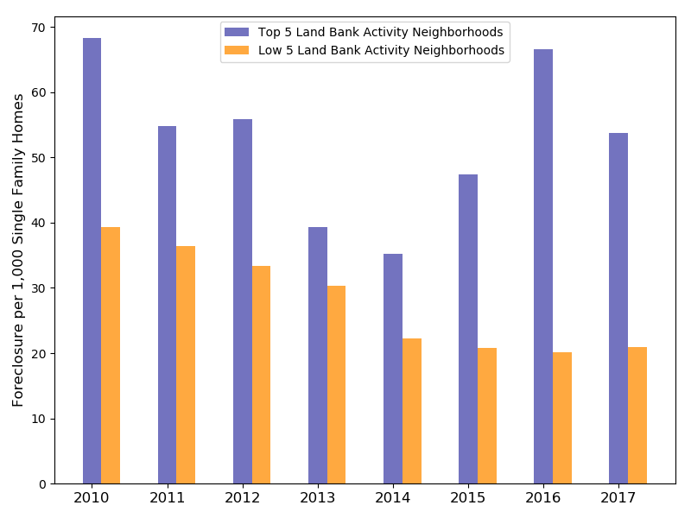
Neighborhods with Highest Current Land Bank Activity

Slide 8
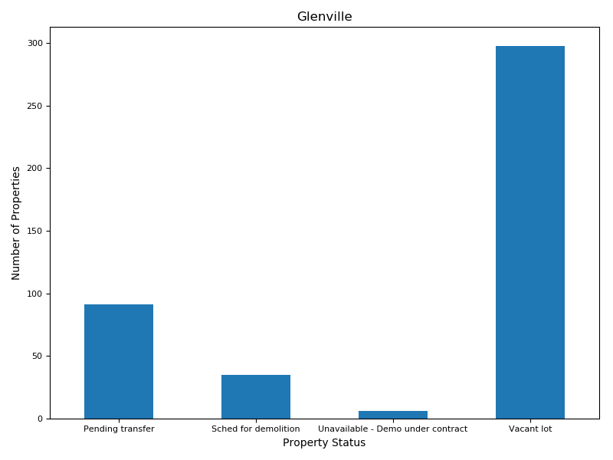
Neighborhoods with Highest Current Land Bank Activity

Slide 9
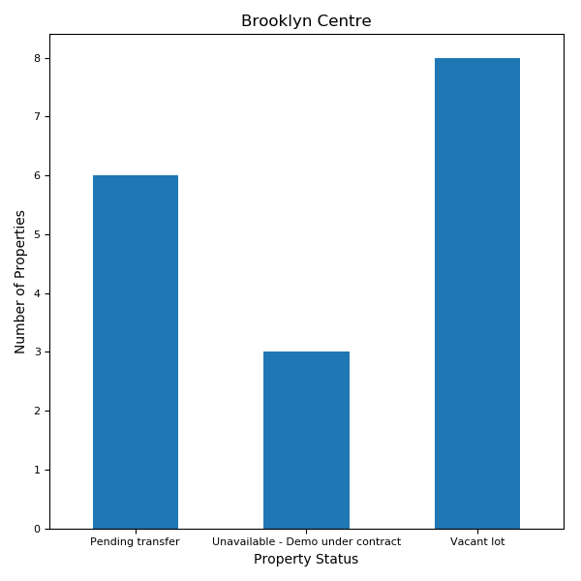
Neighborhoods with Lowest Current Land Bank Activity

Slide 10
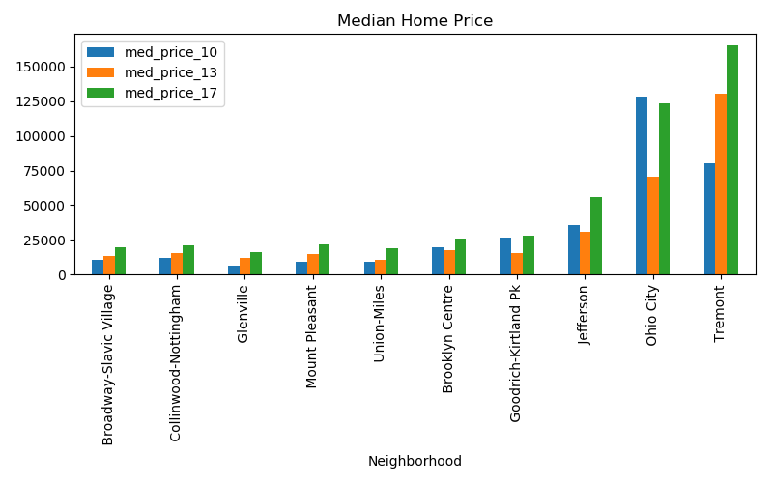

Slide 11
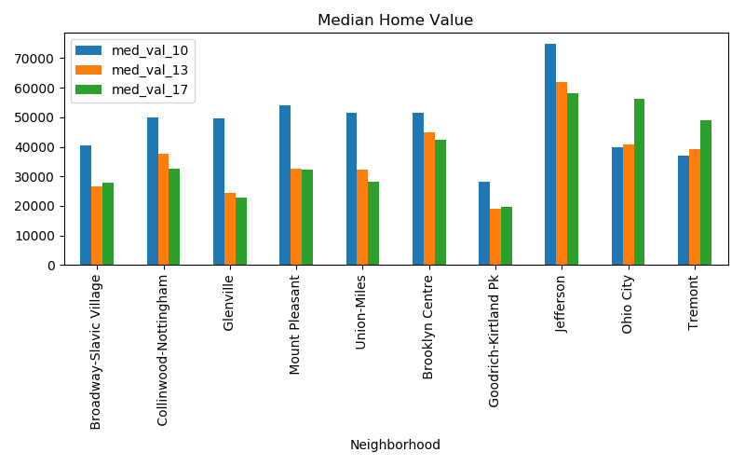

Slide 12
Does the Land Bank Affect School Results?
Originally we were trying to use Ohio Government Data
There is no API, and the website is not great
Fortunately NEOCANDO has test scores by neighborhood
There are multiple tests for 3rd, 4th, 5th, 6th, 7th, 8th, 10th, and 11th grades for years 2010-2016
For all neighborhoods we’re testing, I averaged the scores This allows us to compare them
The graph is on the next page
Note the precipitous drop in 2016 was state-wide, they had to change graduation requirements

Slide 13
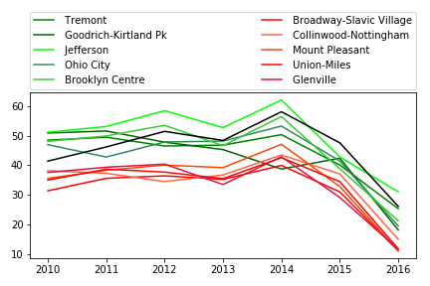

Slide 14
It does not look like the Land Bank Affects Test Scores
But does the math back that up?
To do that I copied the relevant neighborhood scores into a file, got rid of the noise by subtracting the mean suburban score from that year, and did a t test.
Ttest_indResult(statistic=array([9.35983265, 6.11359353, 5.17652858, 7.45770055, 2.21798661, 5.26095049, 4.46843839]), pvalue=array([1.38787037e-05, 2.85170586e-04, 8.46342784e-04, 7.21148008e-05, 5.73619772e-02, 7.63622391e-04, 2.08755103e-03]))
In English: There is a .0000138 chance the land bank affected 2010 test scores, .000285 for 2011, .000846 for 2012, .0000721 for 2013, .0573 for 2014, .000763 for 2015, and .00208 for 2016
If we use 5% as our level of statistical significance, our result of no-result is statistically for every year except 2014

Slide 15

We started with the Indicators csv file and began to and sorted out the neighborhoods we wanted to target in the analysis. We then broke the data down further by just pulling out the crime stats for our selected observation period. We created a bar chart showing each selected neighborhood and the crime data for all three years per neighborhood. From the visualization we can glean that the crime has increased in 80% of the chosen neighborhoods from 2010 to 2013, decreased in 70% of them in 2017.

Slide 16
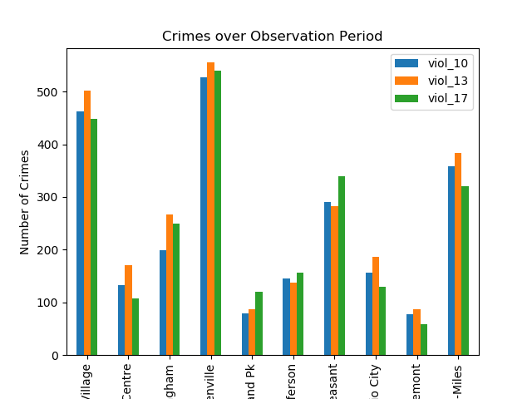

Slide 17
Summarize your conclusions. This should include a numerical summary(i.e., what data did your analysis yield), as well as visualizations of that summary (plots of the final analysis data)

Slide 18
Discuss the implications of your findings. This is where you get to have an open-ended discussion about what your findings “mean”.
Nick will provide answers

Slide 19
Tell a good story! Storytelling through data analysis is no different than in literature. Find your narrative and use your analysis and visualization skills to highlight conflict and resolution in your data.

